Slide 1



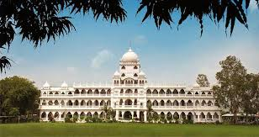
Introducing the ecosystem of
Maharaja Ranjit Singh College of Professional Sciences, Indore
Year 2019-20

Slide 2
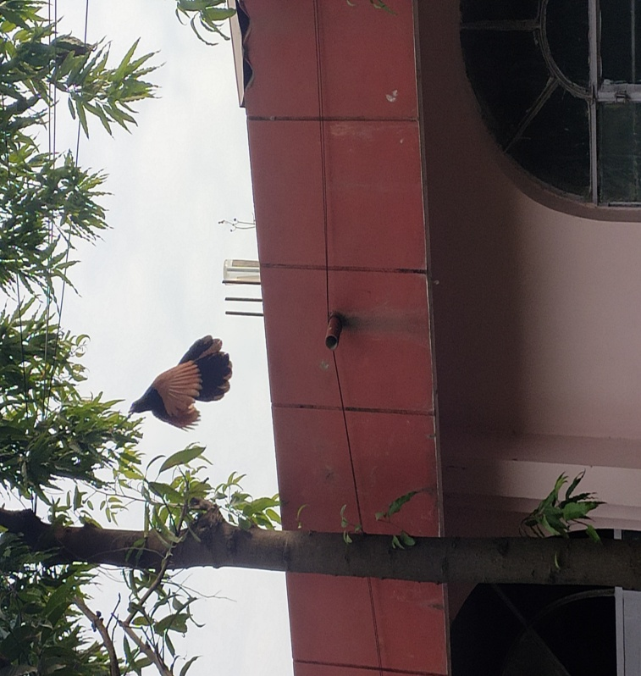
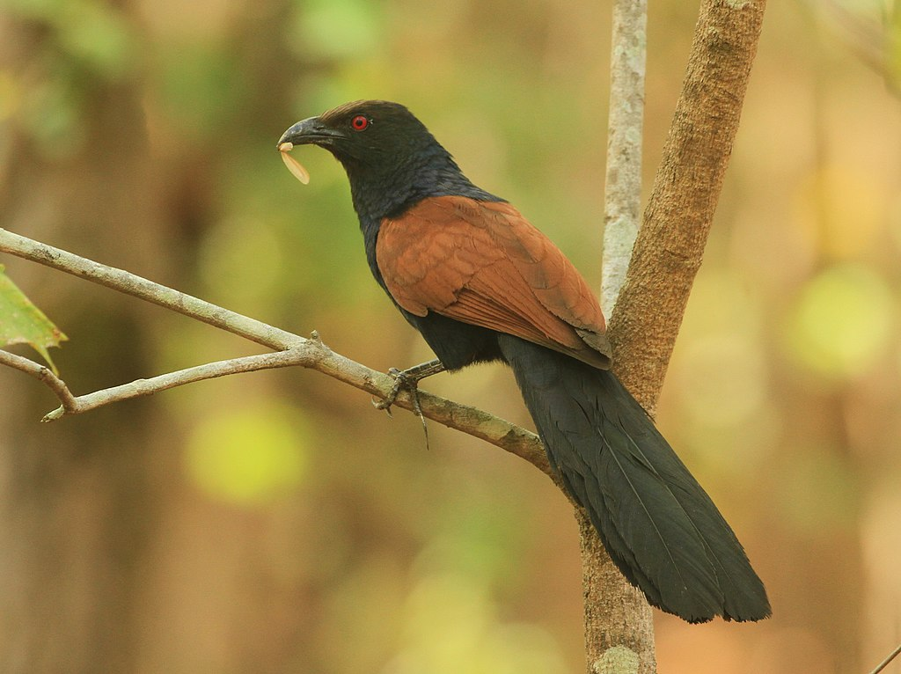
Greater Coucal
Kingdom: Animalia
Phylum: Chordata
Class: Aves
Order: Cuculiformes
Family: Cuculidae
Genus: Centropus
Species: C. sinensis

Slide 3
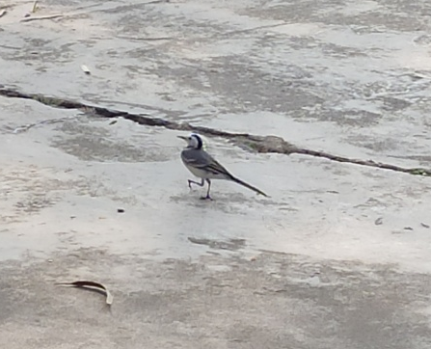
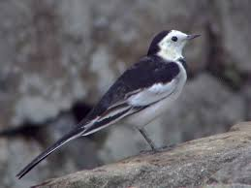
Black Backed Wagtail
Kingdom: Animalia
Phylum: Chordata
Class: Aves
Order: Passeriformes
Family: Motacillidae
Genus: Motacilla
Species: M. alba

Slide 4
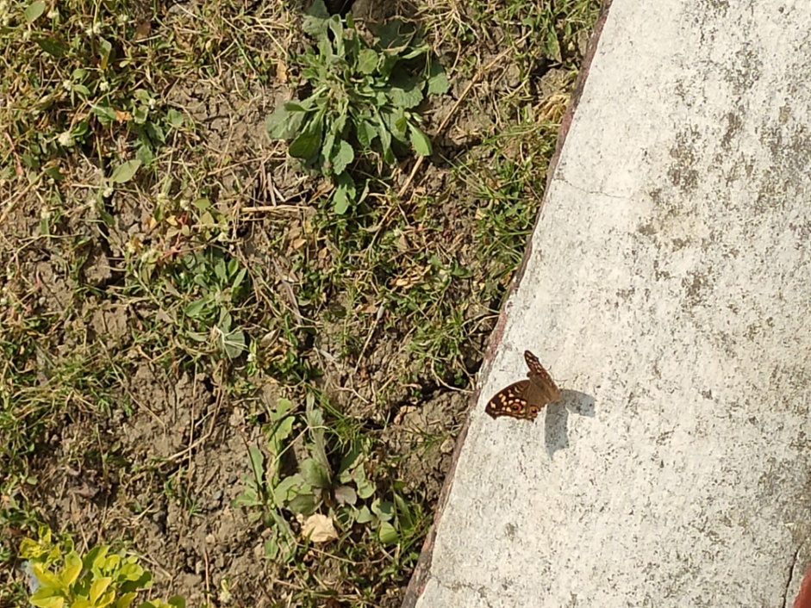
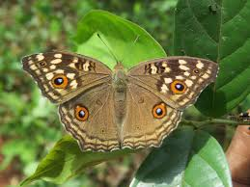
Lemon Pansy
Kingdom: Animalia
Phylum: Arthropoda
Class: Insecta
Order: Lepidoptera
Family: Nymphalidae
Genus: Junonia
Species: J. lemonias

Slide 5
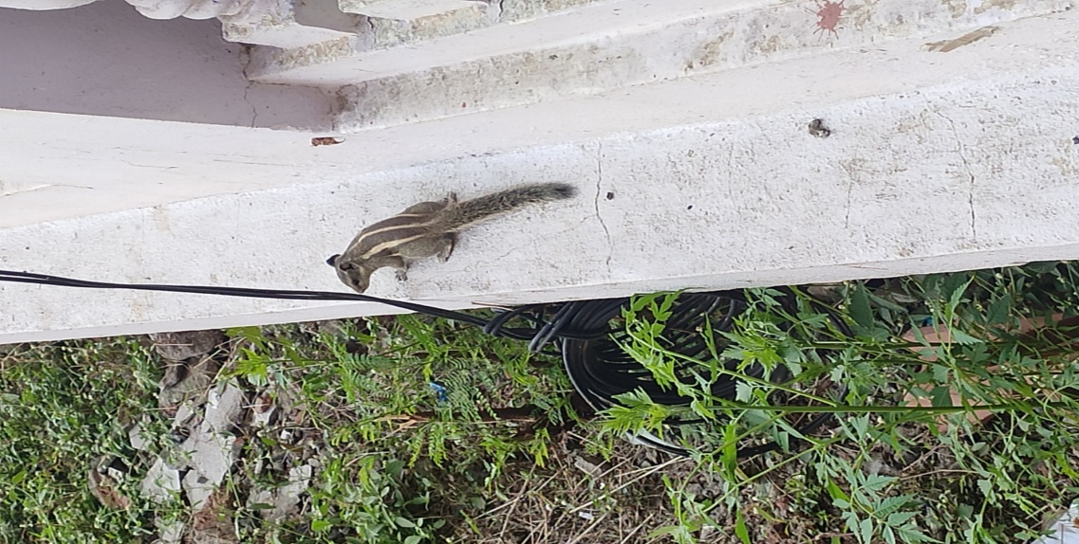
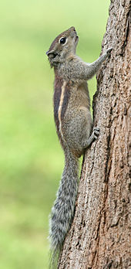
Palm Squirrel
Kingdom: Animalia
Phylum: Chordata
Class: Mammalia
Order: Rodentia
Family: Sciuridae
Genus: Funambulus
Species: F.palmarum

Slide 6
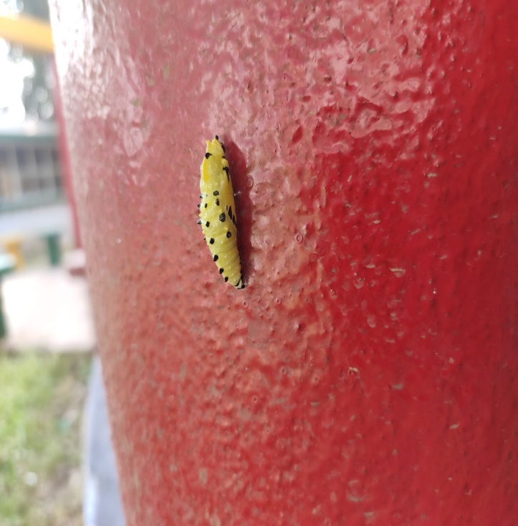
Painted Jezebel
Kingdom: Animalia
Phylum: Arthropoda
Class: Insecta
Order: Lepidoptera
Family: Pieridae
Genus: Delias
Species: D. hyparete metarete

Slide 7
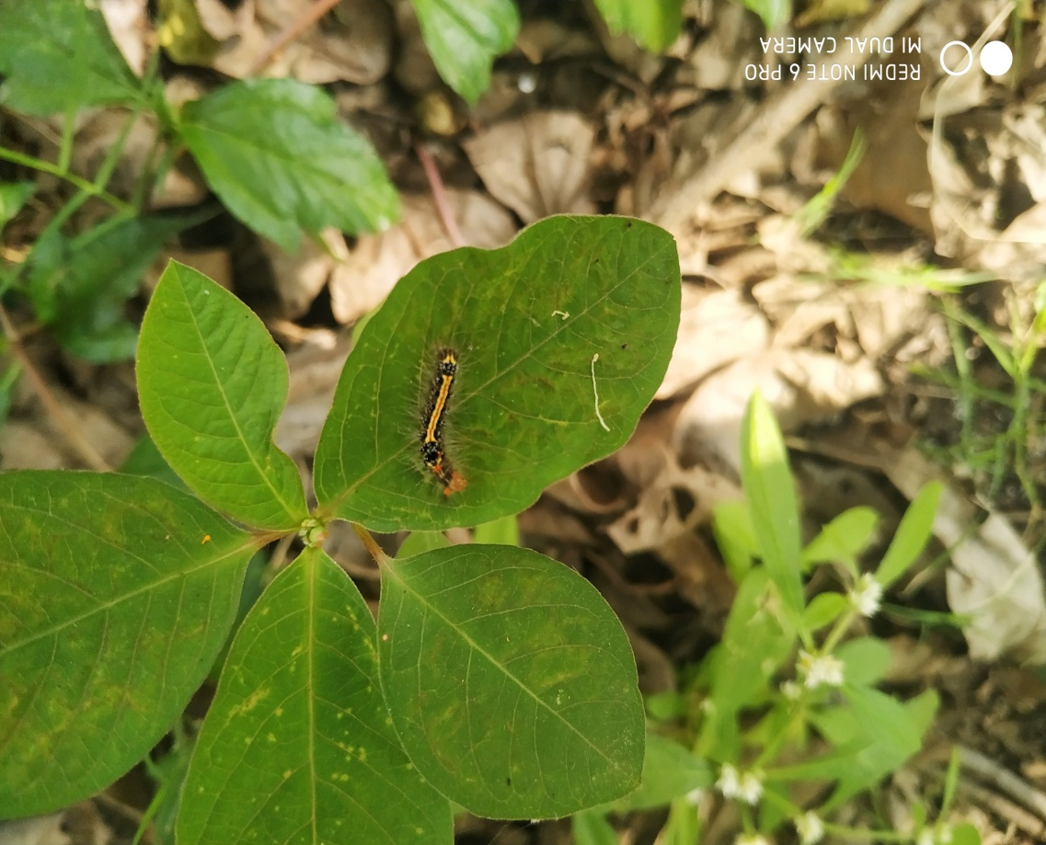
yellow tail caterpillar
Kingdom: Animalia
Phylum: Arthropoda
Class: Insecta
Order: Lepidoptera
Superfamily: Noctuoidea
Family: Erebidae
Genus: Euproctis
Species: E. similis

Slide 8
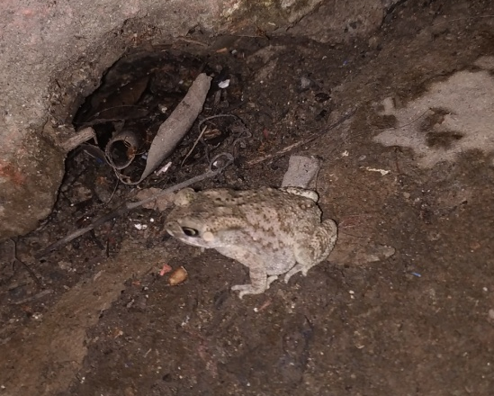
asian common toad
Kingdom: Animalia
Phylum: Chordata
Class: Amphibia
Order: Anura
Family: Bufonidae
Genus: Duttaphrynus
Species: D. melanostictus

Slide 9
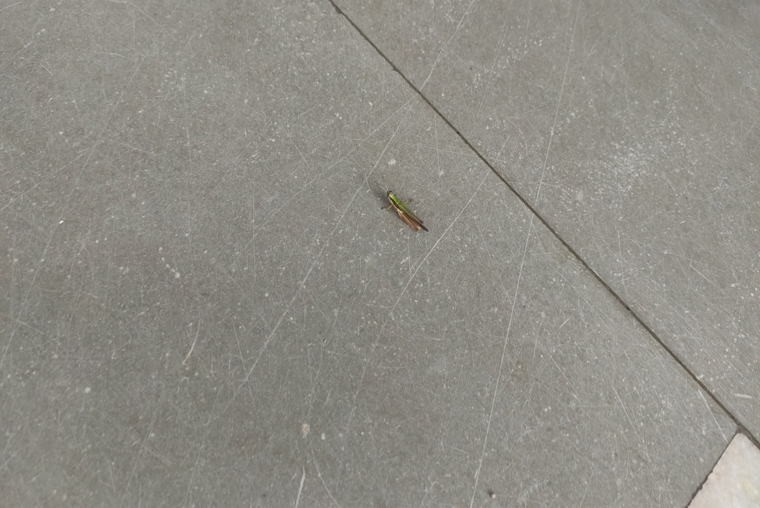
Grass hopper
Kingdom: Animalia
Phylum: Arthropoda
Class: Insecta
Order: Orthoptera
Family: Acrididae
Subfamily: Melanoplinae
Genus: Melanoplus
Species: M. differentialis

Slide 10
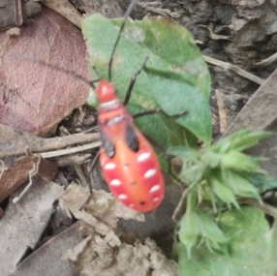
Red cotton bug
Kingdom: Animalia
Phylum: Arthropoda
Class: Insecta
Order: Hemiptera
Family: Pyrrhocoridae
Genus: Dysdercus
Species: D.cingulatus

Slide 11
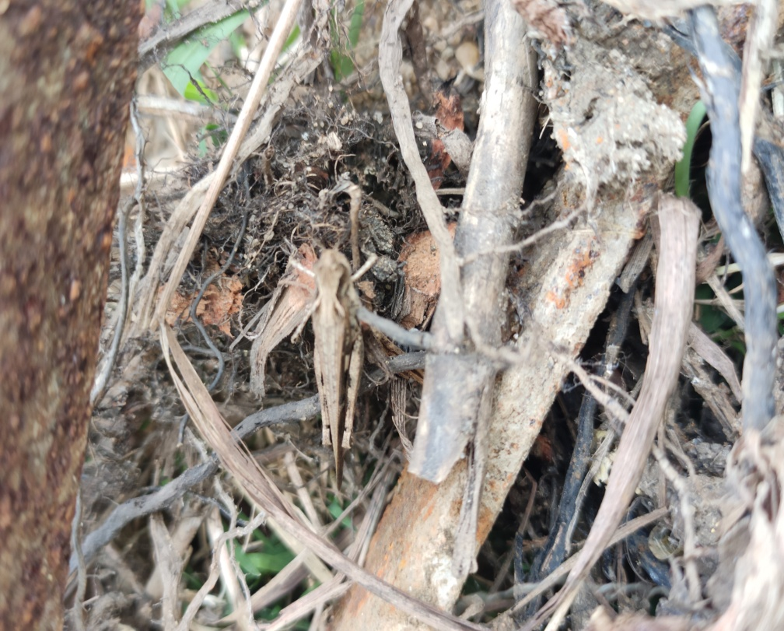
Migratory locust
Kingdom: Animalia
Phylum: Arthropoda
Class: Insecta
Order: Orthoptera
Family: Acrididae
Subfamily: Oedipodinae
Genus: Locusta
Species: L. migratoria

Slide 12
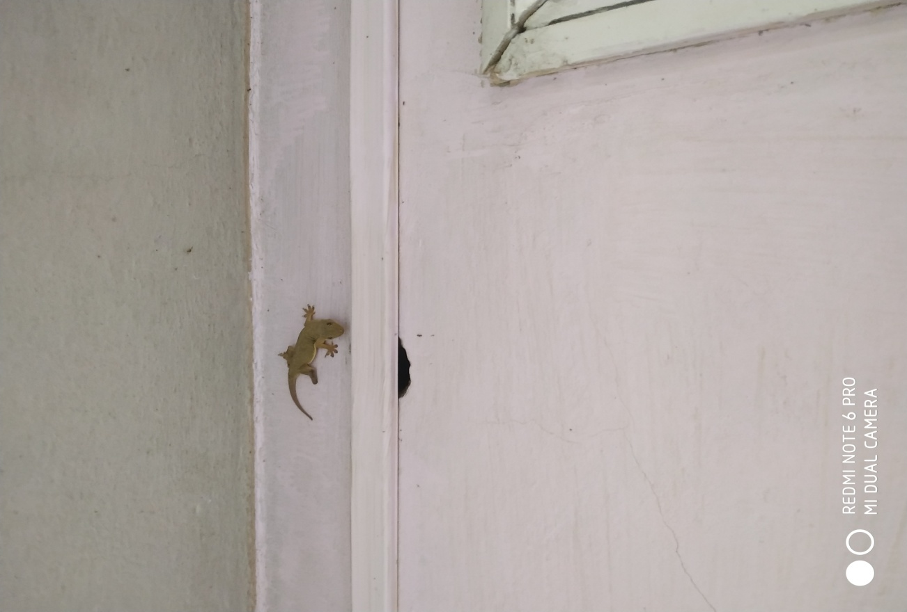
Common Lizard
Kingdom: Animalia
Phylum: Chordata
Class: Reptilia
Order: Squamata
Family: Gekkonidae
Genus: Hemidactylus
Species: H. platyurus

Slide 13
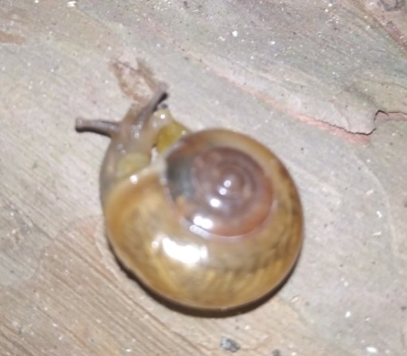
Glass Snail
Kingdom: Animalia
Phylum: Mollusca
Class: Gastropoda
Order: Stylommatophora
Family: Zonitidae
Genus: Oxychilus
Species: Oxychilus draparnaudi

